Slide 1

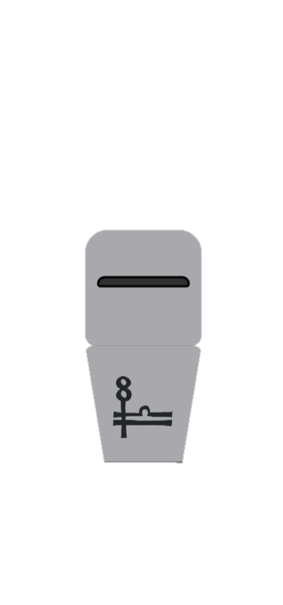



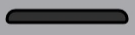








A
B
Learning Phase
Value Dimensions
Transfer Phase
Objective
Value
Relative
Value
Stimulus Presentation
Until choice made
Selection
Display
500 ms
Feedback Presentation
2000 ms
HR
+75
+
Reward
Context
+25
-
LR
-
Punish
Context
-25
+
LP
-75
-
HP
-
Neutral
Context

